Slide 1

Signed and Unsigned Numbers; Logic Gates
Computer Organization and Architecture | Introduction to Digital Fundamentals
Course: Computer Organization and Architecture | Chapter: Introduction to Digital Fundamentals | Program: Bachelor of Engineering
DISCOVER · LEARN · EMPOWER
Notes:
Welcome to today's lecture on the fundamental building blocks of computer organization. We will explore how computers represent numbers and process logic using gates. This session is critical for understanding how hardware interprets data at the lowest level.

Slide 2
Course Outcomes
SLIDE 2 / 14
Course Outcome
CO | BT LEVEL | DESCRIPTION
CO1 | BT3 | Apply number systems and digital logic to design basic digital circuits
CO2 | BT4 | Analyze register organization and instruction set architecture
CO3 | BT3 | Implement computer arithmetic algorithms and floating-point operations
CO4 | BT5 | Analyze memory hierarchy and input-output organization
CO5 | BT6 | Evaluate control unit design and pipelining performance
Chandigarh University
2 / 14
Notes:
Our primary learning outcome for this lecture is CO1. You will learn to apply number systems and digital logic to design basic digital circuits. This means understanding how signed and unsigned representations directly impact circuit design choices.

Slide 3
Learning Objectives
SLIDE 3 / 14
Learning Outcomes
1
Analyze the structural differences between signed and unsigned binary representations.
2
Evaluate the impact of sign bits on arithmetic operations and overflow.
3
Synthesize logic gate circuits to implement basic signed number comparisons.
4
Create truth tables for complex logic functions involving signed inputs.
5
Justify the selection of specific number formats for hardware efficiency.
Chandigarh University
3 / 14
Notes:
By the end of this session, you will be able to analyze how signed and unsigned numbers differ structurally. We will evaluate how sign bits affect arithmetic operations and overflow conditions in real hardware. You will also synthesize logic gate circuits to implement comparisons.

Slide 4
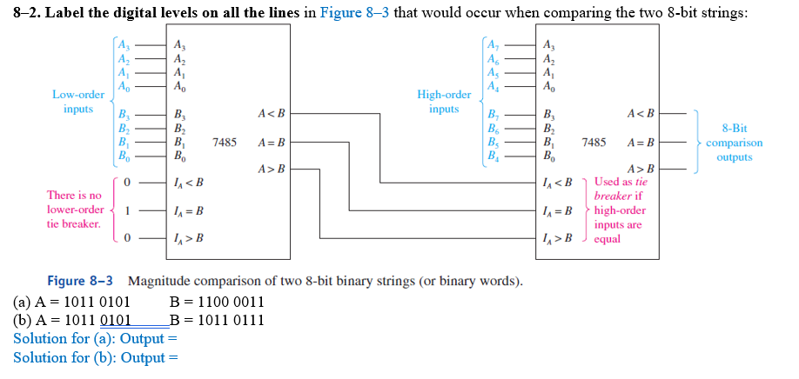
Lecture
SLIDE 4 / 14
Unsigned Number Representation
EXAMPLE
8-bit unsigned max value is 255 (11111111 binary).
• Unsigned numbers represent only non-negative integers starting from zero.
• All bits in the binary string contribute to the magnitude value.
• An n-bit unsigned number ranges from 0 to 2^n - 1.
• No sign bit exists, simplifying hardware addition and subtraction logic.
• Used for memory addresses, counters, and array indices in processors.
• Overflow occurs when result exceeds the maximum representable positive value.
Solved Figure 8-3 Magnitude comparison of two 8-bit binary | Chegg.com
Chandigarh University
4 / 14
Notes:
Unsigned numbers are straightforward; every bit contributes to the value. For an 8-bit system, the maximum value is 255, calculated as 2^8 minus 1. If you add 200 and 100, you get 300, which causes an overflow because it exceeds 255.

Slide 5
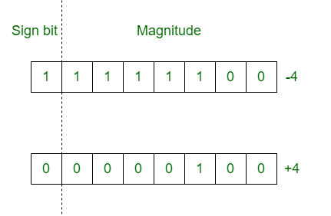
Lecture
SLIDE 5 / 14
Signed Number Representations
THREE COMMON METHODS EXIST
Sign-Magnitude, One's Complement, Two's Complement.
• Signed numbers allow representation of both positive and negative integers.
• The most significant bit (MSB) acts as the sign indicator.
• Two's complement is the industry standard for modern computer arithmetic.
• Sign-Magnitude has two representations for zero, causing hardware complexity.
• One's complement also suffers from the dual zero representation issue.
• Two's complement simplifies subtraction by converting it to addition.
Source: media.geeksforgeeks.org
Chandigarh University
5 / 14
Notes:
Signed numbers require a sign bit, usually the MSB. While Sign-Magnitude and One's Complement exist, Two's Complement is the standard because it simplifies hardware. It eliminates the problem of having two zeros, which complicates circuit design.

Slide 6
Lecture
SLIDE 6 / 14
Two's Complement Mechanics
EXAMPLE
-5 in 8-bit is 11111011 (invert 00000101 then add 1).
• To find the negative of a number, invert all bits and add one.
• The range of an n-bit Two's complement is -2^(n-1) to 2^(n-1)-1.
• Addition and subtraction use the same circuitry for signed and unsigned.
• The sign bit naturally handles the carry-out during arithmetic operations.
• Overflow detection requires checking if the carry-in differs from carry-out.
• This method ensures a unique zero and consistent arithmetic behavior.
Chandigarh University
6 / 14
Notes:
To get the negative of a number in Two's complement, you invert all bits and add one. For example, -5 in 8-bit is 11111011. This method allows the same adder circuit to handle both signed and unsigned addition seamlessly.

Slide 7
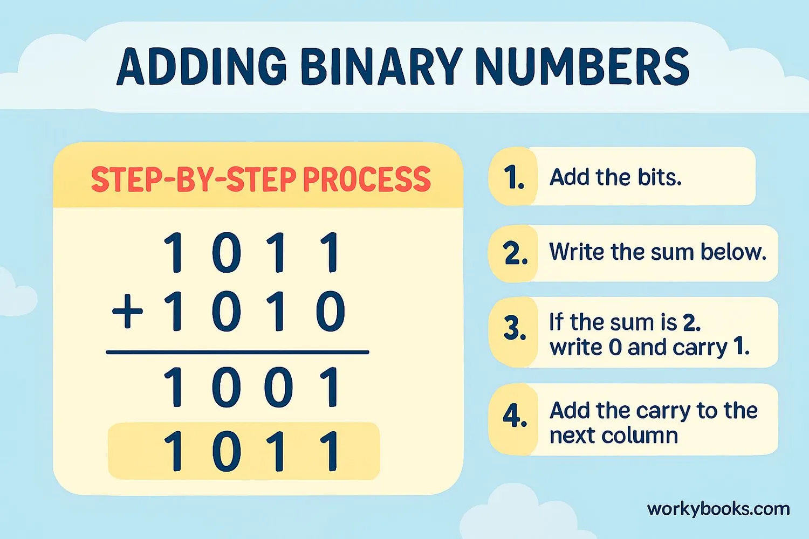
Worked Example
SLIDE 7 / 14
Signed Addition
GOVERNING EQUATION
Perform binary addition: 1101 + 1011 = 11000
CHECK FOR OVERFLOW
carry-in to sign bit was 1, carry-out was 1.
• Add -3 and -5 using 4-bit Two's complement representation.
• -3 is 1101 and -5 is 1011 in 4-bit binary format.
• Discard the carry-out bit, leaving 1000 as the result.
• The result 1000 represents -8 in Two's complement system.
• Since carry-in equals carry-out, no overflow occurred in this case.
Source: assets.workybooks.com
Chandigarh University
7 / 14
Notes:
Let's add -3 and -5 using 4-bit Two's complement. -3 is 1101 and -5 is 1011. Adding them gives 11000. Discarding the carry-out leaves 1000, which is -8. We check for overflow by comparing carry-in and carry-out to the sign bit.

Slide 8
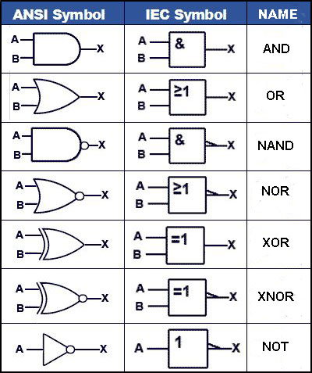
Logic Gates
SLIDE 8 / 14
Basic Operations
1
AND gate outputs 1 only if all inputs are 1.
2
OR gate outputs 1 if at least one input is 1.
3
NOT gate inverts the input signal (0 becomes 1, 1 becomes 0).
4
XOR gate outputs 1 if inputs are different (exclusive difference).
5
NAND and NOR are universal gates capable of implementing any logic.
6
These gates form the physical basis for all digital circuit operations.
7
Speed and power consumption depend on the specific gate technology used.
Source: learnabout-electronics.org
Chandigarh University
8 / 14
Notes:
Logic gates are the physical building blocks of digital circuits. The AND gate outputs 1 only if all inputs are 1, while the OR gate outputs 1 if any input is 1. NAND and NOR gates are universal, meaning you can build any circuit using just one of them.

Slide 9
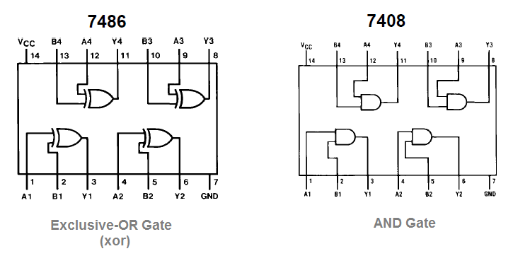
Lecture
SLIDE 9 / 14
Logic Gates and Number Systems
1
XOR gates are essential for implementing binary addition (half adders).
2
AND gates detect specific bit patterns for signed number comparisons.
3
NOT gates are used to invert bits for Two's complement calculation.
4
OR gates combine multiple conditions for overflow detection logic.
5
Complex arithmetic units are built by cascading these basic gates.
6
The choice of gates affects the propagation delay of the circuit.
7
Understanding gate behavior is crucial for optimizing arithmetic logic units.
Source: theorycircuit.com
Chandigarh University
9 / 14
Notes:
Logic gates directly implement number system operations. XOR gates are essential for binary addition, while AND gates help detect specific bit patterns. NOT gates are used to invert bits for Two's complement calculations, showing the deep link between gates and arithmetic.

Slide 10

Common Pitfalls
SLIDE 10 / 14
Signed Arithmetic
1
Confusing unsigned overflow with signed overflow leads to incorrect results.
2
Assuming the same bit pattern represents the same value for both types.
3
Forgetting to extend the sign bit when converting smaller to larger types.
4
Misinterpreting the MSB as a magnitude bit instead of a sign bit.
5
Ignoring the dual zero problem in Sign-Magnitude and One's Complement.
6
Using unsigned comparison logic for signed numbers without sign extension.
7
Overlooking the asymmetry in Two's complement range (more negatives).
Source: static.vecteezy.com
Chandigarh University
10 / 14
Notes:
A common pitfall is confusing unsigned overflow with signed overflow. You might assume the same bit pattern represents the same value for both types, which is false. Always remember to extend the sign bit when converting between different bit widths to preserve the value.

Slide 11
Common Pitfalls
SLIDE 11 / 14
Logic Design
1
Assuming NAND gates are always faster than AND gates in all contexts.
2
Ignoring propagation delay when designing high-speed arithmetic circuits.
3
Overlooking the fan-out limit of a gate driving multiple inputs.
4
Designing complex logic without simplifying using Boolean algebra first.
5
Failing to account for noise margins in real-world signal transmission.
6
Using too many gate levels, increasing the total circuit delay.
7
Neglecting the power consumption implications of high-frequency switching.
Chandigarh University
11 / 14
Notes:
In logic design, a common pitfall is ignoring propagation delay when designing high-speed circuits. You might also overlook the fan-out limit, where a gate cannot drive too many inputs. Always simplify logic using Boolean algebra before implementation to reduce gate levels.

Slide 12
Why This Matters
SLIDE 12 / 14
Hardware Design
1
Correct number representation ensures data integrity in all computations.
2
Efficient logic gate usage reduces chip area and power consumption.
3
Understanding signed arithmetic prevents subtle bugs in embedded systems.
4
Hardware designers must choose formats based on application requirements.
5
Modern processors use Two's complement for its arithmetic simplicity.
6
Logic gate optimization directly impacts the speed of the CPU.
7
Errors in these fundamentals lead to catastrophic system failures.
Chandigarh University
12 / 14
Notes:
Why does this matter? Correct number representation ensures data integrity in all computations. Efficient logic gate usage reduces chip area and power consumption, which is critical for mobile devices. Modern processors use Two's complement for its arithmetic simplicity, making it the standard for hardware designers.

Slide 13
Lecture
SLIDE 13 / 14
Key Takeaways
1
Unsigned numbers use all bits for magnitude, while signed use MSB for sign.
2
Two's complement is the standard for signed arithmetic due to simplicity.
3
Logic gates like XOR and AND form the basis of arithmetic units.
4
Overflow detection differs between signed and unsigned number representations.
5
Proper sign extension is critical when converting between bit widths.
Chandigarh University
13 / 14
Notes:
To summarize, unsigned numbers use all bits for magnitude, while signed numbers use the MSB for the sign. Two's complement is the standard for signed arithmetic because it simplifies hardware design. Remember that overflow detection differs between signed and unsigned representations.

Slide 14
Lecture
SLIDE 14 / 14
References
COMPUTER ORGANIZATION AND DESIGN
The Hardware/Software Interface — David A. Patterson, John L. Hennessy
COMPUTER ARCHITECTURE
A Quantitative Approach — John L. Hennessy, David A. Patterson
• Computer Organization and Architecture — William Stallings
• Computer System Architecture — M. Morris Mano & Rajib Mall
• Computer Organization — Carl Hamacher, Zvonko Vranesic, Safwat Zaky
Chandigarh University
14 / 14
Notes:
For further reading, please refer to the standard texts by Stallings, Mano, Hamacher, and Patterson. These books provide comprehensive coverage of digital fundamentals and computer architecture. I encourage you to review the chapters on number systems and logic design in these references.

